Slide 1
Chapter 9:
Sorting and Searching
Data Structures in Java: From Abstract Data Types to the Java Collections Framework
by Simon Gray

Slide 2
Some Terminology
sort key: The value used to sort the elements of a collection. Maybe be primitive or structured (primary and secondary keys)
total ordering: The elements of the collection are said to be totally ordered if, for any elements x, y, and z from the collection, the following conditions are met:
reflexive: x == x
transitive: if x ≤ y and y ≤ z, then x ≤ z
antisymmetric: if x ≤ y and y ≤ x, then x == y
total: either x ≤ y or y ≤ x

Slide 3
Some Terminology
increasing order (also called sorted or ascending order): The elements in the sorted collection are unique (no duplicates) and are ordered such that
e₁ < e₂ < e₃ < …. < e_{n}. For example: 2 < 5 < 16
nondecreasing order: The elements in the sorted collection may contain duplicates and are sorted such that e₁ ≤ e₂ ≤ e₃ ≤ …. ≤ e_{n}. For example: 2 ≤ 5 ≤ 5 ≤ 21
decreasing order (also called reverse sorted or descending order): The elements in the sorted collection are unique (no duplicates) and are ordered such that
e₁ > e₂ > e₃ > …. > e_{n}. For example: 21 > 16 > 5 > 2

Slide 4
Some Terminology
nonincreasing order: The elements in the sorted collection may contain duplicates and are sorted such that e₁ ≥ e₂ ≥ e₃ ≥ …. ≥ e_{n}. For example: 21 ≥ 5 ≥ 5 ≥ 2
stable sort: Duplicates from the unsorted collection appear in the same relative order in the sorted collection. That is, if e_{i} == e_{j} and i < j, then e_{i} will appear before e_{j} in the sorted sequence. In the following example, the subscripts to 5 show their relative order in the unsorted sequence.
  Unsorted collection: 5₁ 2 6 5₂ 4
  Sorted, stable: 2 4 5₁ 5₂ 6
  Sorted, not stable: 2 4 5₂ 5₁ 6
in-place sort: The extra space required to store the data during the sort is independent of the size of the input. The space complexity of such an algorithm is O(1)

Slide 5
Selection Sort
First, let’s borrow an idea from the last chapter
when we looked at searching. Split the “sort
space” into sorted and unsorted parts.
Pseudocode: selectionSort( primitiveType [] array )
1. while the size of the unsorted part is greater than 1
2. find the position of the largest element in the unsorted part
3. move this largest element into the first position of the sorted part
4. decrement the size of the unsorted part by 1
// invariant: all elements from the first position to the last position of the
// sorted part are in non-decreasing order

Slide 6
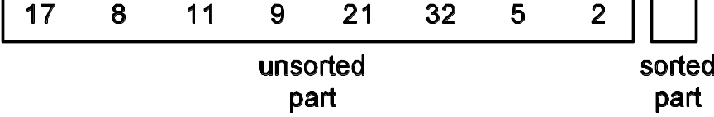
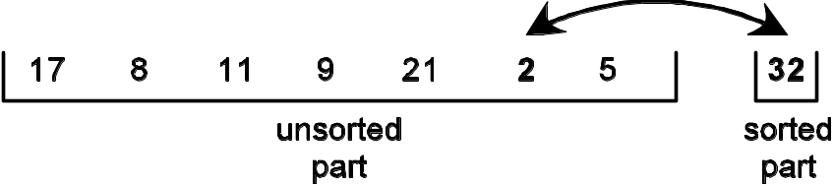
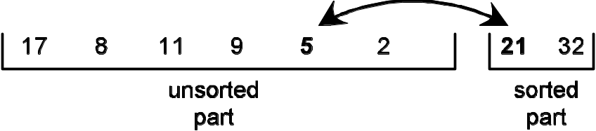
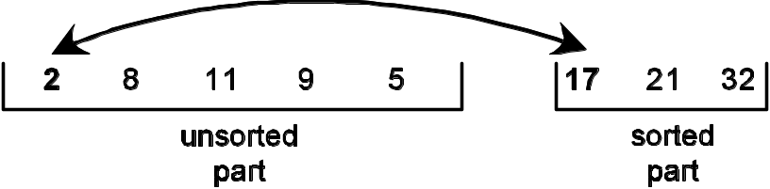
Selection Sort: The Picture
(a) Initial configuration for selection sort. The input array is logically split into an unsorted part and a sorted part.
(b) The array after the largest value from the unsorted part has been moved to the front of the sorted part (first pass).
(c) The array after the largest value from the unsorted part has been moved to the front of the sorted part (second pass).
(d) The array after the largest value from the unsorted part has been moved to the front of the sorted part (third pass).

Slide 7
Selection Sort Time Complexity
What should we count? How about comparison of elements?
# iterations of the inner loop per iteration of the outer loop
# iterations of the outer loop
1 *
*
1 * Ο(n) * Ο(n) = Ο(n²)
Space complexity: O(1) – only need space for local variables

Slide 8
Insertion Sort
Pseudocode: insertionSort ( primitiveType [] array )
1. while the size of the unsorted part is greater than 0
2. let the target element be the first element in the unsorted part
3. find target’s insertion point in the sorted part
4. insert the target in its final, sorted position
// invariant: the elements from position 0 to (size of the sorted part – 1)
// are in nondecreasing order
Pseudocode finding the insertion point for the target in the sorted part
1. get a copy of the first element in the unsorted part
2. while ( there are elements in the unsorted part to examine AND
we haven’t found the insertion point for the target )
3. move the sorted element up a position // make room for the target

Slide 9
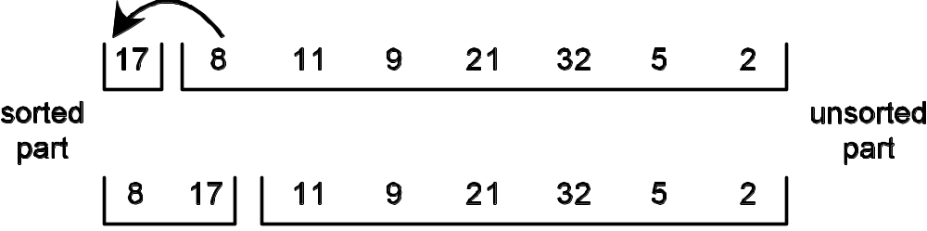
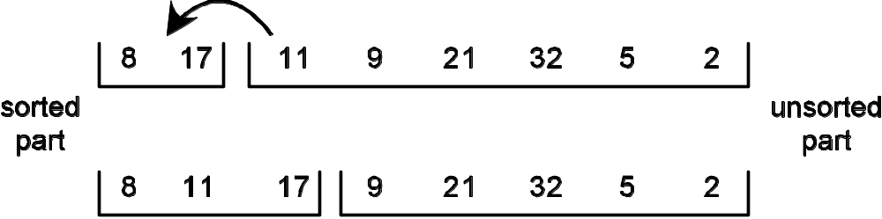
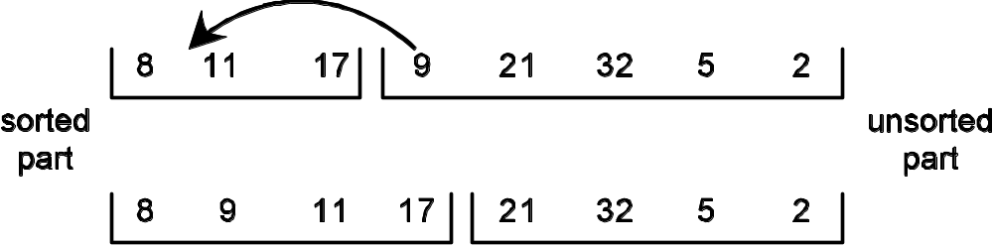
Insertion Sort: The Picture
(a) Initial configuration for insertion sort. The input array is logically split into a sorted part (starting with one element) and an unsorted part.
(b) The array after the first value from the unsorted part has been inserted in its proper position in the sorted part (first pass).
(c) The array after the first value from the unsorted part has been inserted in its proper position in the sorted part (second pass).
(d) The array after the first value from the unsorted part has been inserted in its proper position in the sorted part (third pass).

Slide 10
Insertion Sort Time Complexity
Again, we count comparison of elements
# iterations of the inner loop per iteration of the outer loop
# iterations of the
outer loop
1 *
  *
1 * Ο(n) * Ο(n) = Ο(n²)
Space complexity: O(1) – only need space for local variables

Slide 11
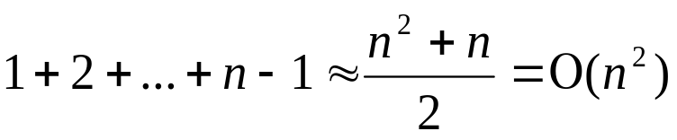
Comparison Based on Data Moves
Instead of comparing element comparisons, what if we count the number of data moves made?
Selection Sort always knows where the next element is going to go, but it doesn’t know which element to move. Worst case? n –1 swaps
Insertion Sort knows which element to insert into the sorted part, but it doesn’t know where in the sorted part it will go. Worst case? O(n²) swaps

Slide 12
Quick Sort
The k^{th} smallest value algorithm sorted the input to the point that the pivot for a partition ended up in position k – 1
If we continue with the partitioning step on the unsorted partitions, can we sort the input? Yes!
This is the idea behind Quick Sort

Slide 13
Quick Sort
QuickSort( collection,
first,
last )
collection, if size(collection ) ≤ 1
// base case
QuickSort(collection, first, pivotPosition – 1 )
// recursive case —
sort left partition
QuickSort(collection, pivotPosition + 1, last )
// recursive case —
sort right partition
if size( collection ) > 1
where
collection – the collection to be sorted
pivotPosition = partition( collection, first, last )
first – the index of the first element of collection
last – the index of the last element of collection

Slide 14
Quick Sort: Implementation
As is common,
the code follows the definition very closely
1 void quickSort( int[] array, int first, int last ) {
2 if ( first >= last ) // base case
3 return;
4
5 int pivotPosition = partition( array, first, last );
6
7 // recursive case: sort left partition
8 quickSort( array, first, pivotPosition-1 );
9
10 // recursive case: sort right partition
11 quickSort( array, pivotPosition+1, last );
12 }

Slide 15
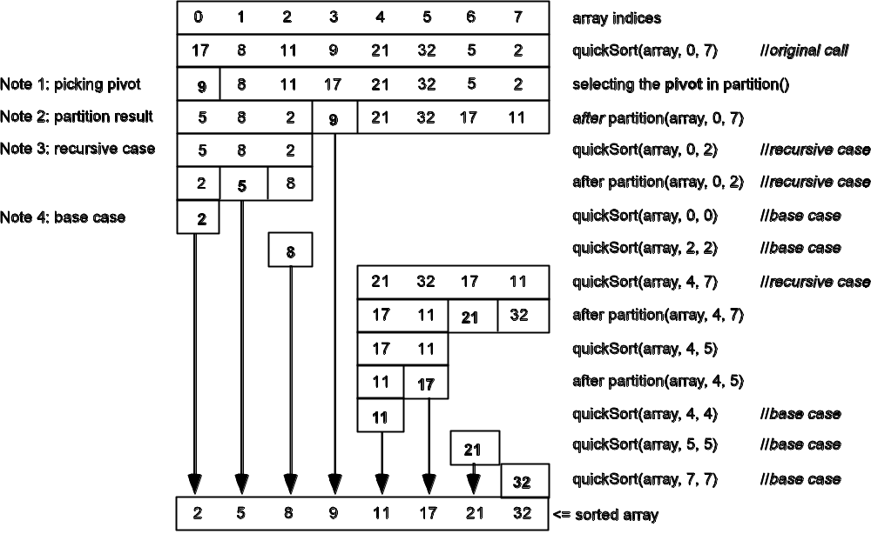
Quick Sort: An Example

Slide 16
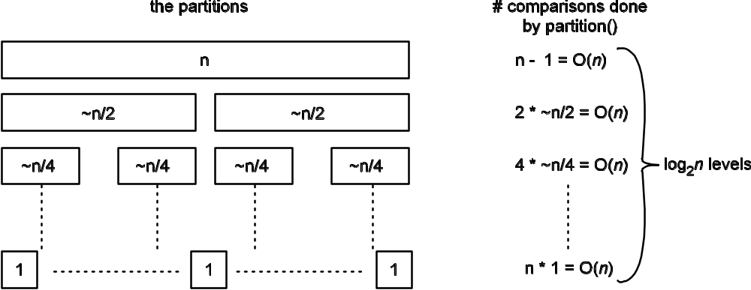
Quick Sort: Using A “Good” Pivot
Space complexity: O(log₂n) for the activation records
If the pivot “evenly” splits the partition, there will be log₂n levels, each of which requires O(n) comparisons: O(nlog₂n) time complexity

Slide 17
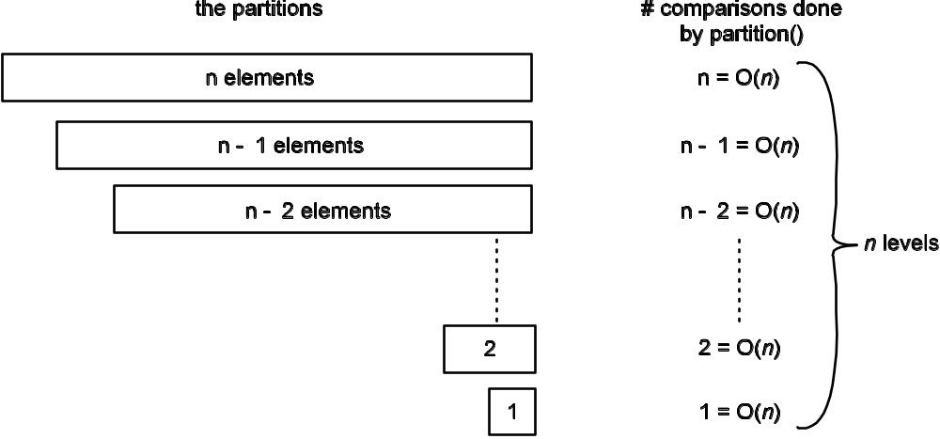
Quick Sort: Using A “Bad” Pivot
Space complexity:
O(n) for the activation
records
If the pivot always produces one empty partition and one with n – 1 elements, there will be n levels, each of which requires O(n) comparisons: O(n²) time complexity

Slide 18
Merge Sort
Since having partitions of the same size is so important to performance, is there some way we can guarantee equally sized performance? Yes!
Idea:
  Recursively split the partitions into equal chunks until each partition is of size 1 (so sorted)
  As the recursion unwinds, merge the sorted partitions

Slide 19
Merge Sort
collection, if size( coll ) ≤ 1
// base case
MergeSort(collection,
first,
last )
MergeSort(collection, first, midpoint – 1)
// recursive case — sort left partition
MergeSort(collection, midpoint, last)
// recursive case — sort right partition
merge ( collection, first, midpoint, last )
// merge left and right partitions
if size( collection ) > 1
where
collection – the collection to be sorted
first – the index of the first element of coll
midpoint – (first + last + 1) / 2
last – the index of the last element of coll

Slide 20
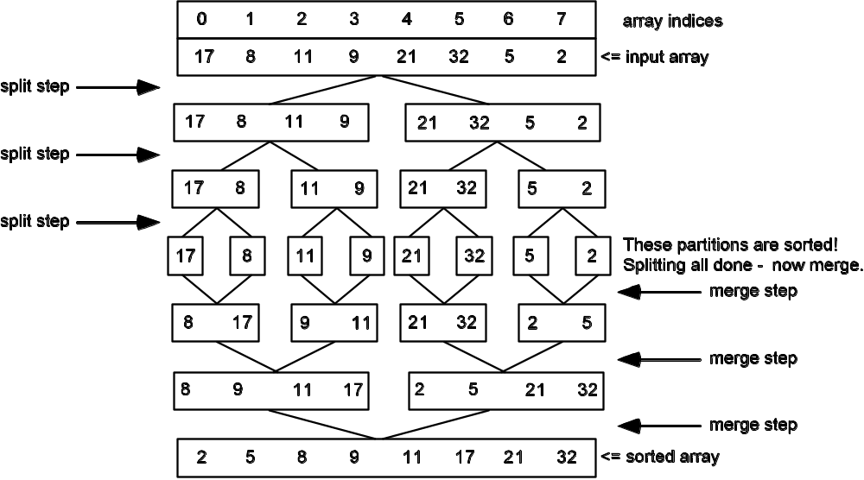
Merge Sort: An Example
split
steps
merge
steps
Merge Sort follows a series of splitting steps with a series of merging steps to produce sorted partitions

Slide 21
Merge Sort: Time/Space Complexity
Time complexity: Merge Sort guarantees that each split produces partitions of the same size (or off by 1), guaranteeing there will be log₂n levels
There are n comparisons done on each level
⇒ O(nlog₂n) comparisons are done
Space complexity: a little trickier – extra space is needed to merge the elements, but this can be minimized. Still, O(n) space complexity

Slide 22
Comparison of Sorting Algorithms
Algorithm | Time Complexity |  | Space Complexity
 | Average Case | Worst Case | Average Case | Worst Case
Selection sort | Ο(n²) | Ο(n²) | Ο(1) | Ο(1)
Insertion sort | Ο(n²) | Ο(n²) | Ο(1) | Ο(1)
Quick sort | Ο(nlog₂n) | Ο(n²) | Ο(log₂n) | Ο(n)
Merge sort | Ο(nlog₂n) | Ο(nlog₂n) | Ο(n) | Ο(n)

Slide 23
Comparing Objects
Sorting a collection of objects is different from sorting a collection of primitives
The relational operators applied to objects compares the references, not the values of the objects
Use the Comparable<T> interface

Slide 24
The Comparable<T> Interface
public interface Comparable<T>
{
int compareTo( T o );
}
obj1.compareTo(obj2) returns
• a negative integer if obj1 is “less than” obj2
• a positive integer if obj1 is “greater than” obj2
• zero if obj1 is “equal to” obj2
Test Using compareTo()to Compare Objects | Equivalent Relational Operation to Compare Primitives
a.compareTo( b ) < 0 | a < b
a.compareTo( b ) > 0 | a > b
a.compareTo( b ) == 0 | a == b
a.compareTo( b ) != 0 | a != b
a.compareTo( b ) <= 0 | a <= b
a.compareTo( b ) >= 0 | a >= b

Slide 25
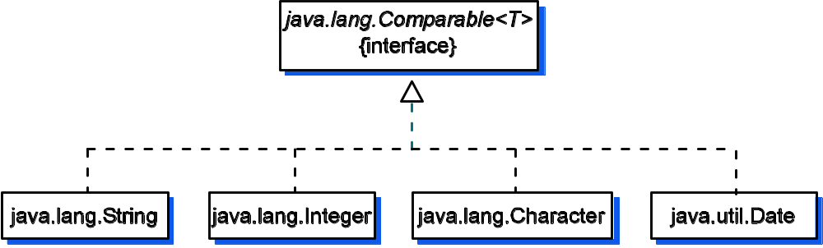
How to Make a Class Comparable
// The String class declares that it implements
// the Comparable interface so that an instance of
// itself can be compared to another String.
public class String implements Comparable<String>
Note the use of a specific type in the type
parameter field. This guarantees that we
can only compare Strings to Strings

Slide 26
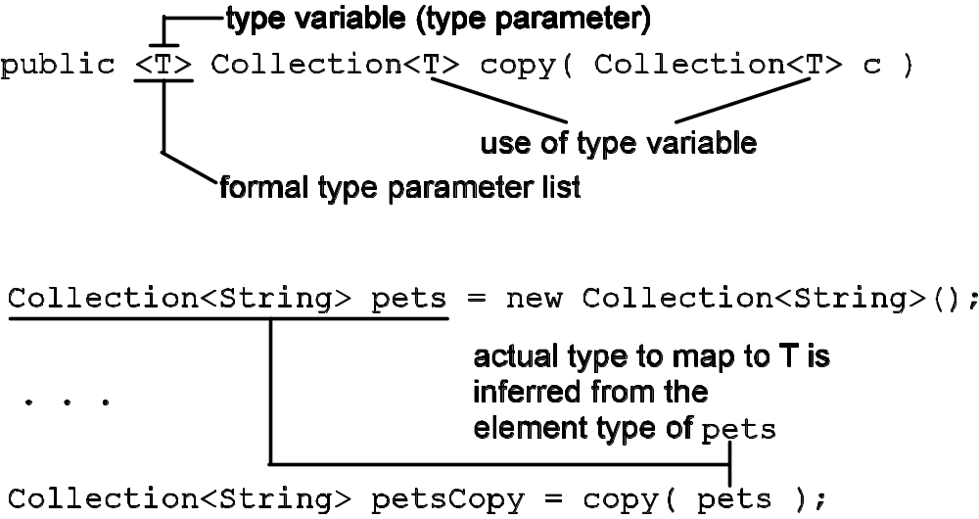
Generic Methods
Remember, just as classes can be generic, so can methods
Declaration
Application

Slide 27
Selection Sort as a Generic Method
What should the type of the parameter be?
First attempt:
<T> void selectionSort( T[], int n)
Not quite right. The method doesn’t know enough about the actual type that will map to T
We need to be sure that whatever type T ends up being, its elements are Comparable to one another

Slide 28
Selection Sort as a Generic Method
What we need for our generic method is a way to say that instances of the actual type passed in for T are comparable to one another
Second attempt:
<T extends Comparable<T>> void selectionSort( T[] a, int n )
This means selectionSort() can sort instances of any type T that implements Comparable

Slide 29
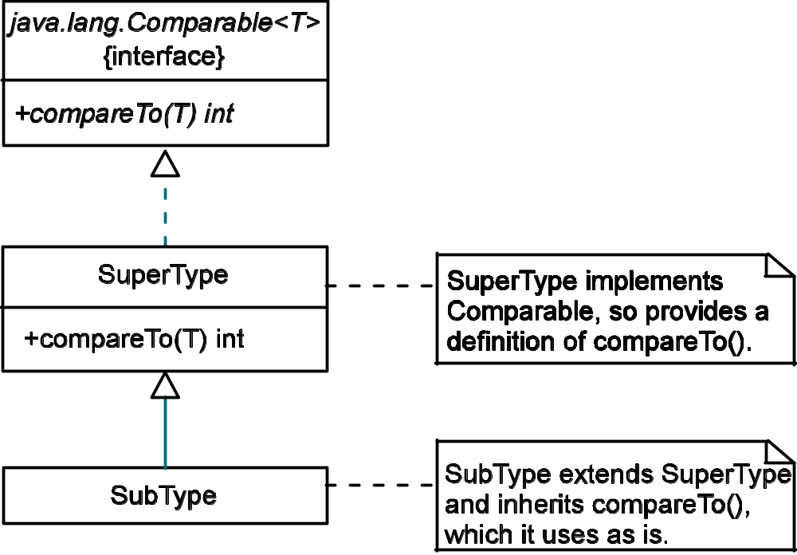
Selection Sort as a Generic Method
Problem: The second attempt means that the class we provide for T must implement Comparable itself: It cannot have inherited the compareTo() method from a superclass that implemented Comparable.
I want my sort method
to be able to sort objects
of type SuperType and
SubType. The header in
attempt 2 would only
allow my to sort objects
of type SuperType. ☹

Slide 30
Selection Sort as a Generic Method
We need a way to say that either T implements Comparable itself or that some supertype of T implements Comparable, in which case T will inherit that class’s compareTo() method
Solution: combine the ? wildcard with the keyword super to specify a type lower bound (e.g., <? super T> describes a family of types bounded below by T). Our header is now
<T extends Comparable<? super T>> void selectionSort(T[], int n)
This means the method accepts an array of any type T (the lower bound) that implements Comparable or has a supertype (ancestor) that implements Comparable

Slide 31
Updating Selection Sort for Objects
/**
* Sort the array elements in ascending order
* using selection sort.
* @param a - the array of integers to sort
* @param n – the number of elements in a to sort
* @throws NullPointerException if a is null
* @throws IndexOutOfBoundsException if <tt>n</tt>
* is greater than <tt>a.length</tt>
*/
static void selectionSort( int[] a, int n ) {
if ( a == null )
throw new NullPointerException();
if ( n > a.length )
throw new IndexOutOfBoundsException();
// while the size of the unsorted part is > 1
for ( int unsortedSize = n;
unsortedSize > 1; unsortedSize-- ) {
// find the position of the largest
// element in the unsorted section
int maxPos = 0;
for (int pos = 1; pos < unsortedSize; pos++)
if ( a[pos] > a[maxPos] )
maxPos = pos;
// postcondition: maxPos is the position
// of the largest element in the unsorted
// part of the array
// Swap largest value with the last value
// in the unsorted part
int temp = a[unsortedSize - 1];
a[unsortedSize - 1] = a[maxPos];
a[maxPos] = temp;
}
}
/**
* Sort the array elements in ascending order
* using selection sort.
* @param a - array of Comparable objects to sort
* @param n – the number of elements in a to sort
* @throws NullPointerException if a is null
* @throws IndexOutOfBoundsException if <tt>n</tt>
* is greater than <tt>a.length</tt>
*/
static <T extends Comparable<? super T>>
void selectionSort( T[] a, int n ) {
if ( a == null )
throw new NullPointerException();
if ( n > a.length )
throw new IndexOutOfBoundsException();
// while the size of the unsorted part is > 1
for ( int unsortedSize = n;
unsortedSize > 1; unsortedSize-- ) {
// find the position of the largest
// element in the unsorted section
int maxPos = 0;
for (int pos = 1; pos < unsortedSize; pos++)
if ( a[pos].compareTo(a[maxPos]) > 0 )
maxPos = pos;
// postcondition: maxPos is the position
// of the largest element in the unsorted
// part of the array
// Swap largest value with the last value
// in the unsorted part
T temp = a[unsortedSize - 1];
a[unsortedSize - 1] = a[maxPos];
a[maxPos] = temp;
}
}
Only the code in red
had to be changed!

Slide 32
Making a Class Comparable
Comparable defines a total ordering on the objects of a class that implements it
This is called the class’s natural ordering and the compareTo() method of a class is called its natural comparison method
It is considered good practice to make sure that x.equals(y) for all objects for which x.compareTo(y) == 0

Slide 33
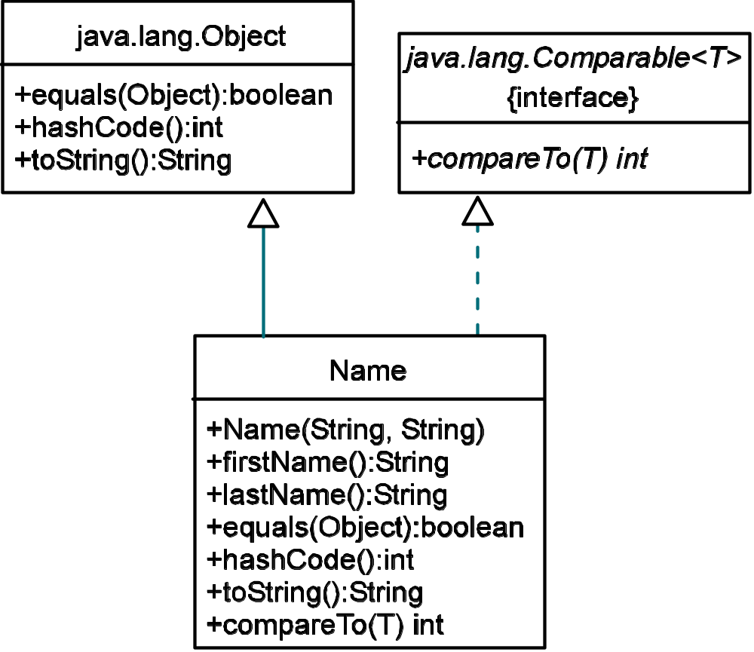
Making Name Comparable
The natural sort order for names is lexicographical by last name, then first name.
If we override equals(),
we must also override
hashCode() to honor
the contract for equals()

Slide 34
Making Name Comparable
1 /**
2 * The <tt>Name</tt> class stores a person’s first and last name.
3 */
4 public class Name implements Comparable<Name> {
5
6 private String firstName;
7 private String lastName;
8
9 // CONSTRUCTORS, ACCESSORS, AND MUTATORS NOT SHOWN
10
11 /**
12 * Determine if this name is equal to the given argument.
13 * @param o The <tt>Name</tt> object to which we are to compare
14 * this <tt>Name</tt>
15 * @return true if both the first and last name of this
16 * <tt>Name</tt> match the first and last names of the given
17 * argument; otherwise return false.
18 */
19 public boolean equals( Object o ) {
20 if ( o instanceof Name )
21 return this.compareTo( (Name)o ) == 0;
22 return false;
23 }
Ensure that we say that a Name
is only Comparable to another Name
make sure that x.equals(y) for all objects for which x.compareTo(y) == 0

Slide 35
Making Name Comparable
25 /**
26 * Return the hashcode for this <tt>Name</tt>.
27 * @return The hashcode for this name.
28 */
29 public int hashCode(){
30 return 31 * this.lastName.hashCode() +
31 this.firstName.hashCode();
32 }
By the contract for equals() in Object, if o1.equals(o2),
then o1.hashCode == o2.hashCode. So, if we override equals(), we must override hashCode().

Slide 36
Making Name Comparable
34 /**
35 * Compare this <tt>Name</tt> to the <tt>Name</tt> supplied in
36 * the argument.
37 * @param o The <tt>Name</tt> to which to compare this
38 * <tt>Name</tt>.
39 * @return -1 if this name is lexicographically less than the
40 * other name.<BR>
41 * 0 if they are equal<BR>
42 * 1 if this name is lexicographically greater than the
43 * other name
44 * @throws <tt>IllegalArgumentException</tt> if
45 * <tt>other</tt> is <tt>null</tt>
46 */
47 public int compareTo( Name other ){
48
49 if ( other == null )
50 throw new IllegalArgumentException();
51
52 int result = 0;
53 if ( this.lastName.compareTo( other.lastName() ) < 0 )
54 result = -1;
55 else if (this.lastName.compareTo( other.lastName() ) == 0)
56 result = this.firstName.compareTo( other.firstName() );
57
58 return result;
59 }
The natural sort order for names is lexicographical by last name, then first name

Slide 37
Searching for Objects
The mechanisms used to sort objects, Comparable and Comparator, apply equally well to searching for objects in a collection
We can modify the search algorithms from Chapter 8 to search for objects just as in this chapter we adapted sort algorithms for primitive types to sort objects:
  1. Change the line that does the comparison of elements to use Comparable.compareTo() or Comparator.compare()
  2. Change the method header

Slide 38
Example: binarySearch() for objects
<T extends Comparable< ? super T > >
int binarySearch( T[] array, int first, int last, T target ){
if ( first > last )
return -1; // Base case - failure
if ( ( first < 0 ) || ( first >= array.length ) ||
( last < 0 ) || ( last >= array.length ) )
throw new IndexOutOfBoundsException();
int mid = ( first + last ) / 2;
if ( array[ mid ].compareTo( target ) == 0 )
return mid; // Base case - success
// recursive cases
if ( array[ mid ].compareTo( target ) < 0 )
return binarySearch( array, mid + 1, last, target );
else
return binarySearch( array, first, mid - 1, target );
}

